Slide 1







Software University: Learning Program
Become a Software Engineer and Start a Job
SoftUni Team
Technical Trainers
Software University
https://softuni.bg

Slide 2
Table of Contents
Welcome to SoftUni
SoftUni Partners
SoftUni Trainers
Learning Paths and Opportunities

Slide 3
Questions?
sli.do
#fund-common

Slide 4
The SoftUni Family
Quality Digital Education for Thousands

Slide 5
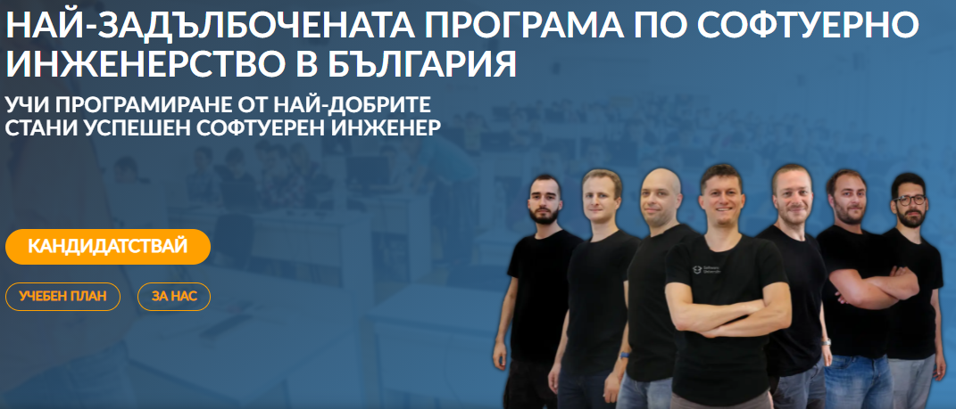
Software Engineering Learning Program
The "Software University" learning program @ SoftUni
Become a professional software engineer in ~ 1-2 years
Professions:
C# / .NET Web Developer
Java & Spring Web Developer
JavaScript Web Developer
Python & Django Web Developer
Curriculum: https://softuni.bg/curriculum

Slide 6

SoftUni Partners
Tech Companies, Who Support SoftUni

Slide 7











SoftUni Diamond Partners

Slide 8


Educational Partners

Slide 9




XS Software
Gaming company, founded back in 2005 in Sofia
Over 50,000,000 registered players
Introduced the first browser games in Bulgaria
Looking for PHP Game Dev

Slide 10
Coca-Cola HBC – Bulgaria
Coca‑Cola HBC is one of the world's largest bottlers of brands from the Coca‑Cola company
CCHBC started operations in Bulgaria in 1992 and since then is one of the biggest contributors to the local economy
Global company with over 30 thousand engaged people
https://bg.coca-colahellenic.com

Slide 11
CreateX
Site design
Website optimization – SEO
Online advertising – PPC
Social media marketing
Copywriting
Creative concept and design
https://createx.bg/

Slide 12
SmartIT
12+ years programming business-orientated solutions
ERP Systems
Mobile iOS & Android
Server Management
Sofia, Plovdiv, Varna and Ruse offices
Looking for .NET developers
https://www.smartit.bg

Slide 13

Draft Kings
Award-winning sports betting solutions
iGaming platform
Looking for developers, mostly with JS and .NET
https://www.sbtech.com/careers

Slide 14
SuperHosting
The largest hosting company in Bulgaria
Hosting
Domains
WordPress Hosting
VPS Servers
SSL Certificates
E-Commerce
Offering a complete solution
Top-quality support
Top-qualified team
Leading technical equipment

Slide 15
Indeavr
Business and technology services company
Business application development
Infrastructure services
Collaboration services
Looking for trainee and junior .NET Developers
https://www.indeavr.com/en/careers

Slide 16

Taulia
Global FinTech platform
Microservices. CI/CD. Autonomous teams.
Java-based stack. Open to developers with any tech background.
https://taulia.com/company/careers/

Slide 17



Software Group
Integration solutions for financial institutions
Provide digital transformation
Discovering Potential
Driving Innovation
Unlocking Opportunities

Slide 18

Postbank
One of the top banking institutions in Bulgaria
Employer of the year for 2017
Member of the Eurobank Group with € 58 billion of assets
Serious investments in digitization
The first bank credit botchat – EVA
https://www.facebook.com/evapostbank
https://www.postbank.bg/Za-nas/Careers

Slide 19

Motion Software
Development of innovative Web and mobile projects
40 clients in 15 countries
Financial apps, blockchain, e-commerce, artificial intelligence, big data
Friendly community and availability for 100% remote work
https://motion-software.com

Slide 20

The Trainers
The Trainers for the Software Engineering Program

Slide 21
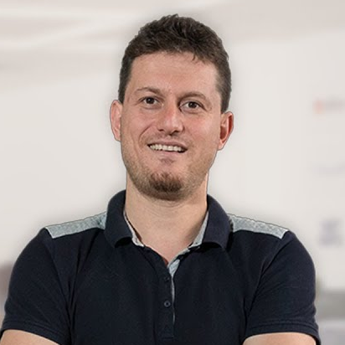
Svetlin Nakov, PhD
Co-Founder of SoftUni
Training & Inspiration Manager @ Software University (SoftUni)
20+ years as software developer
10+ years experience as trainer
Author of 8 programming books
Speaker at hundreds of events
Web site & blog: nakov.com

Slide 22
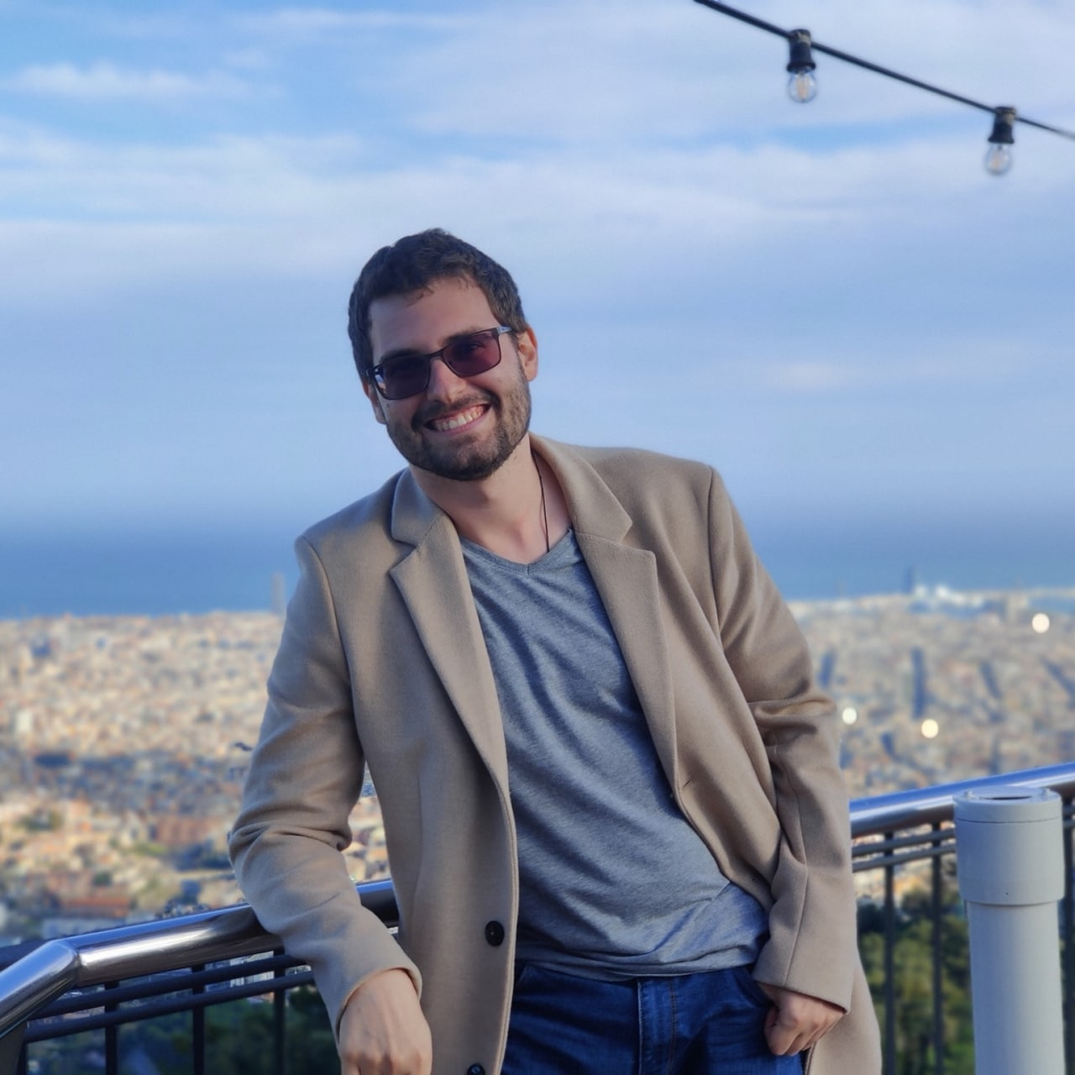
Teodor Kurtev
Experience with .NET and MEAN ecosystems
Senior software engineer in News UK Bulgaria
Working with GoLang and Amazon Web Services

Slide 23
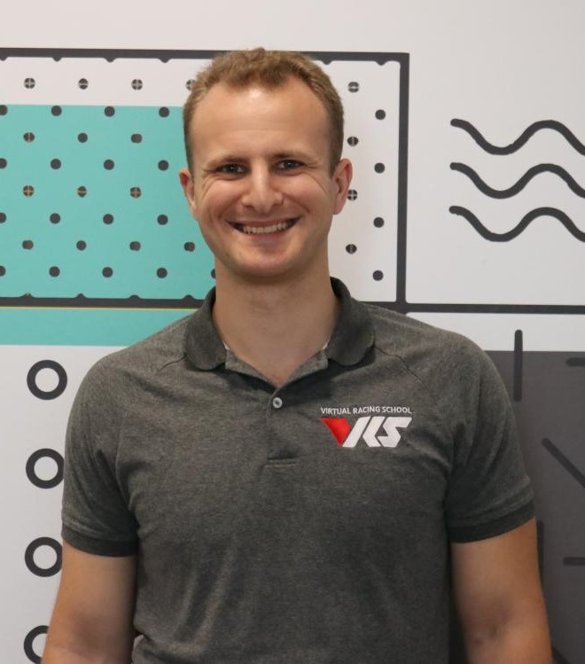
Georgi Georgiev
Technical trainer @ SoftUni
C++, C#, Java, Data Structures and others
Developer @ VirtualRacingSchool.com
Java, JavaScript, C++
Experience
4+ years training, 10+ years coding
Wrote a driving simulator once in high school (DriveFreeZ award)
Played around with OpenGL, Bullet Physics SDK, WinRT

Slide 24
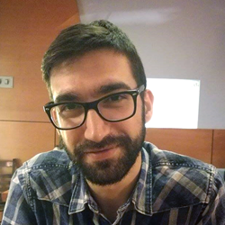
Viktor Kostadinov
Nearly 5 years experience as a technical trainer in the IT field
Head of the R&D Unit at Software University
Former Director of the Education Department
JavaScript enthusiast

Slide 25
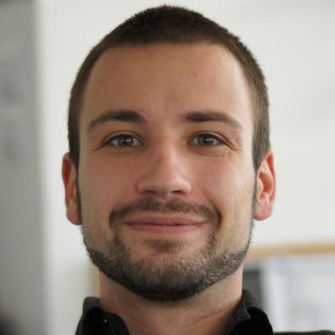
Angel Georgiev
Educational Director at SoftUni
15+ years of experience as a Technical Trainer and a Product Presenter
Founder and Business OWL at Znam.bе
Fluent in Java, C#, HTML/CSS, JavaScript, Python, PHP, SQL

Slide 26
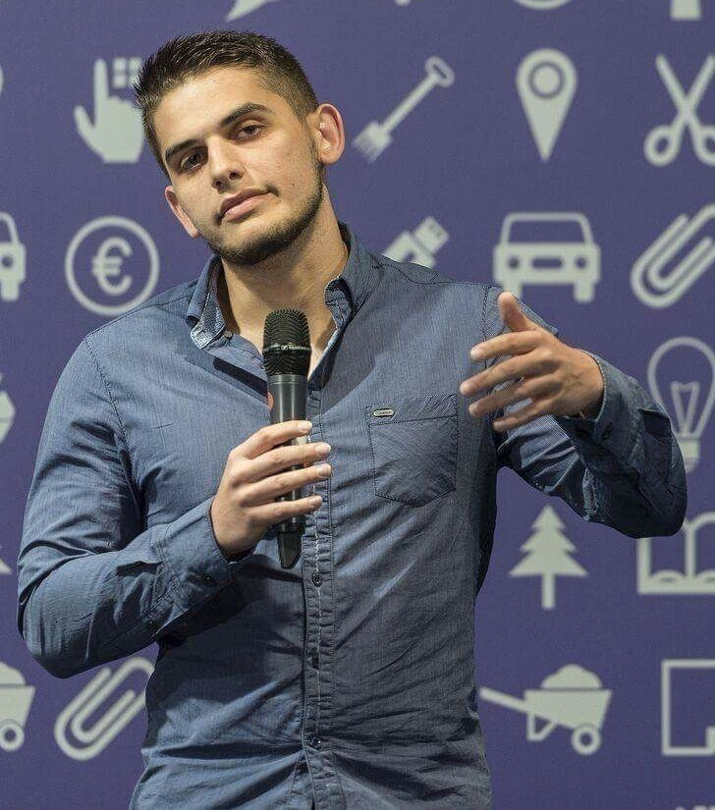
Viktor Dakov
Senior Developer SDE 3, Nuvolo
Worked at Amazon
John Atanasoff award
Participated in many programming contests
6+ years of experience as a developer

Slide 27
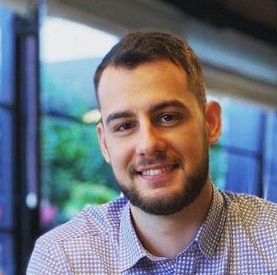
Dimo Georgiev
Software Developer @ SAP
Oracle Certified Java Professional
Computer and Software Engineering at Technical university of Sofia

Slide 28
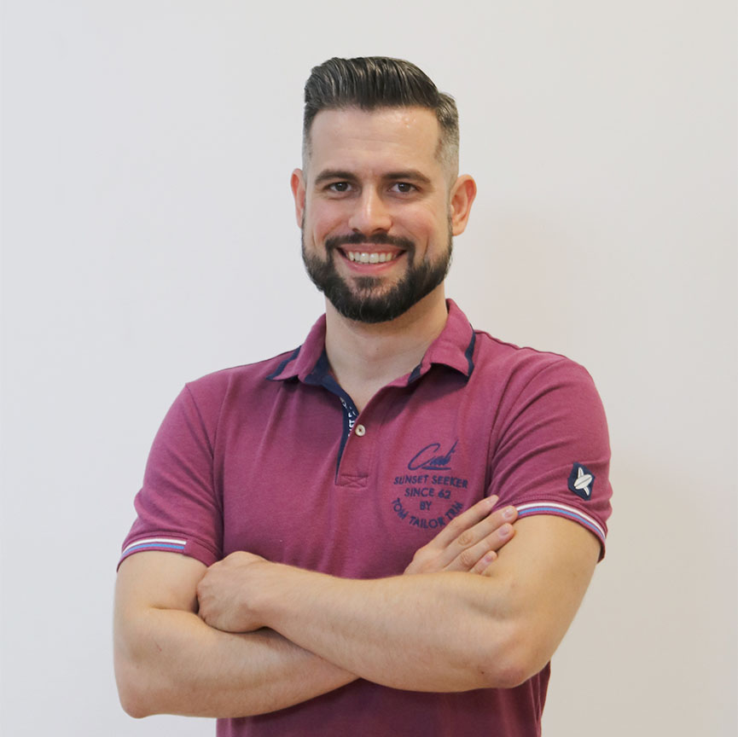
Ivaylo Papazov
Senior Full-Stack Developer and Team Lead @ Motion Software
Technical Trainer @ SoftUni
Experience in JS, C#, Node.js, React, ASP.NET MVC
TelerikAcademy Graduate

Slide 29
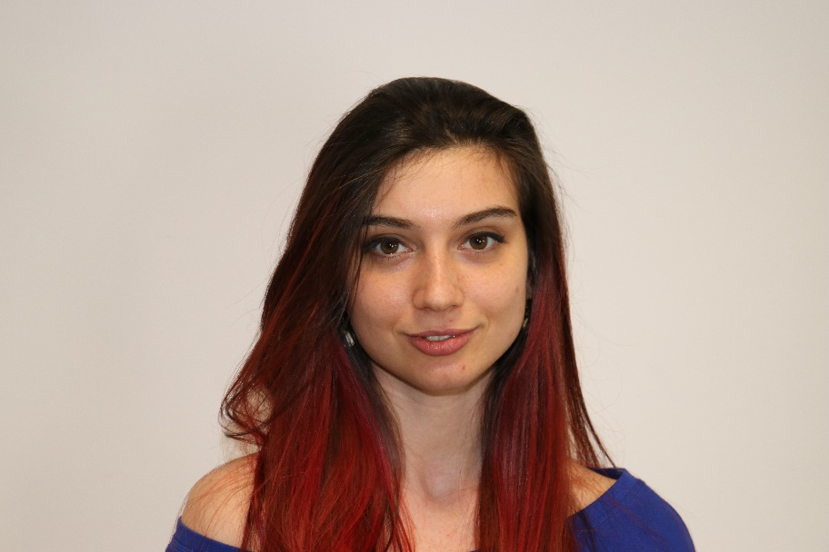
Ines Ivanova
Python Software Engineer at IQVIA
Full stack freelance developer
Python, Django
C#, Angular
HTML, CSS
jQuery, Flask, Docker

Slide 30
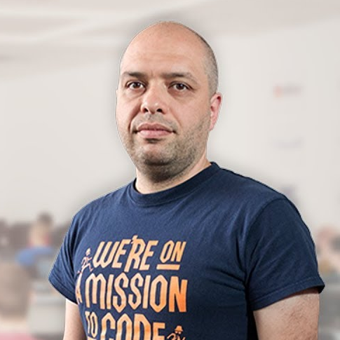
Stamo Petkov
Head Of Department at Information Services Plc.
Worked with various technologies
.NET and C#, BASIC, Pascal, Object Pascal, PHP
More than 15 years of experience
Experienced Technical Trainer

Slide 31
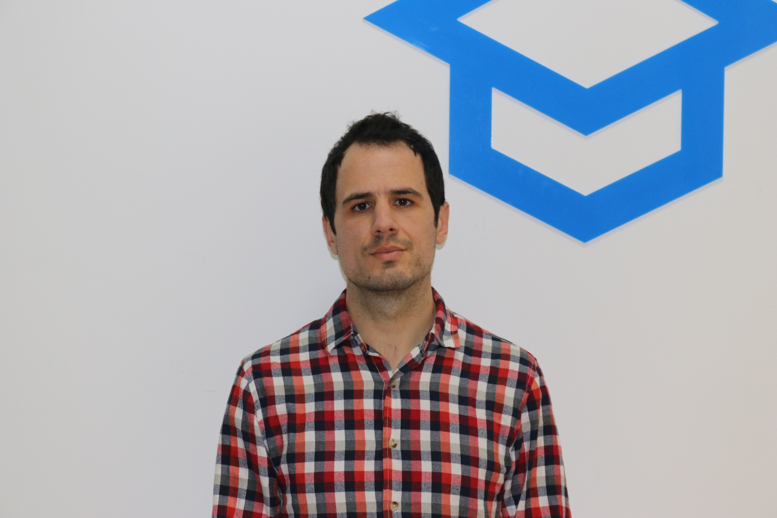
Veselin Vachev
Team Lead @ Netinfo
9 years full-stack web developer
Back-end / front-end, SEO, UX
Making CD / CI Systems
Current projects: Gong.bg, Nova.bg, Dariknews.bg, Vesti.bg, Sinoptik.bg

Slide 32
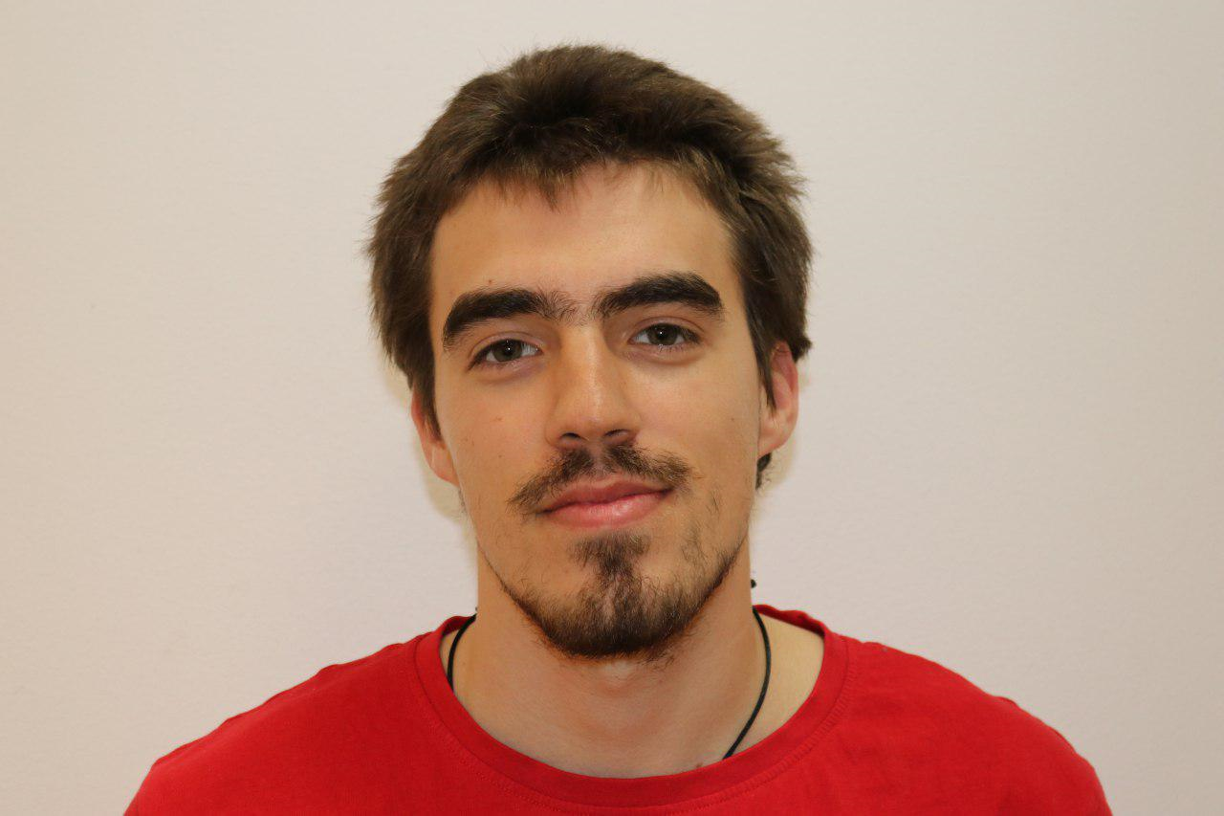
Nikolay Bankin
Software Engineer with many years of experience with various technologies
Teacher at TUES
Many years of experience as a Trainer
He has worked with Scala, Akka, Java and JavaScript

Slide 33
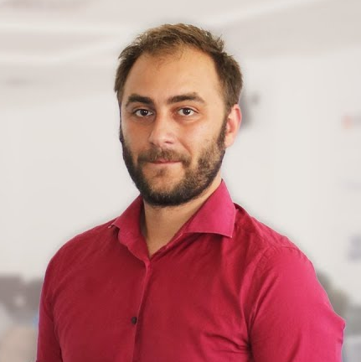
Doncho Minkov
Senior Full Stack Developer in SoftUni
10+ years in IT
8+ years of experience as a Technical Trainer in Telerik Academy
Front-end developer by heart
Software developer by need
Experience with all popular mobile platforms
Android, iOS, Windows
Fluent in Node.js, .NET, Angular, Java, C++
"30 under 30" - Forbes 2017 - Education

Slide 34
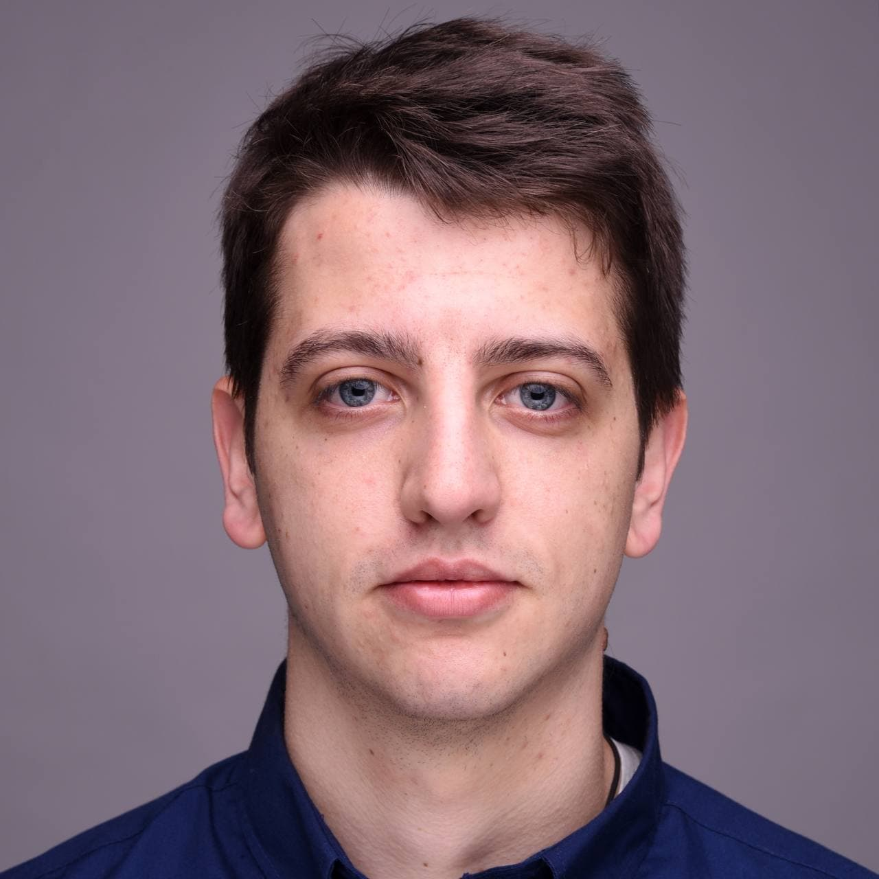
Georgi Stoimenov
Technical Trainer @ SoftUni
Front-End Developer @VMware and is working on the whole process of developing:
Design, Implementation, Testing, Optimizing
Top Student @ SoftUni
Experience in creating Enterprise applications with Angular

Slide 35
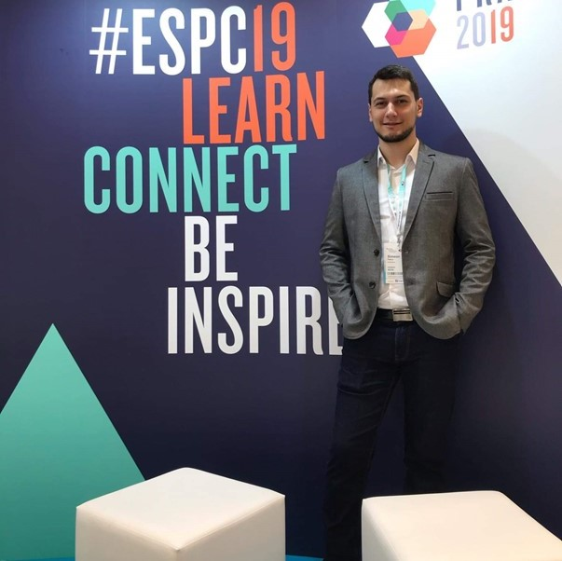
Simeon Petrov
Front-end Developer @ Blubito AG
Passionate about Vue, JavaScript & CSS
Experienced with Vue, React, Gatsby, Svelte, Angular
Getting involved more with NodeJS & Python

Slide 36
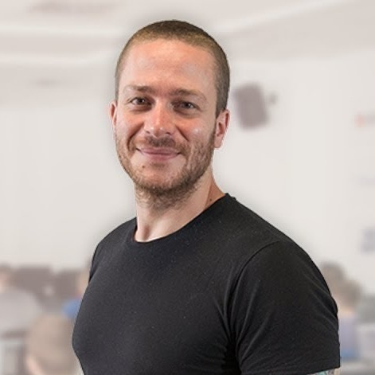
Ivaylo Kenov
Various job titles at the same time:
CTO @ SoftUni Dev Team
Technical Trainer @ SoftUni
Creator of open-source libraries for ASP.NET
MyTested.AspNetCore.Mvc
Mathematical competitions champion
Contacts:
https://github.com/ivaylokenov
https://linkedin.com/in/kenov

Slide 37

Learning Paths and Opportunities
The Choice is Yours

Slide 38
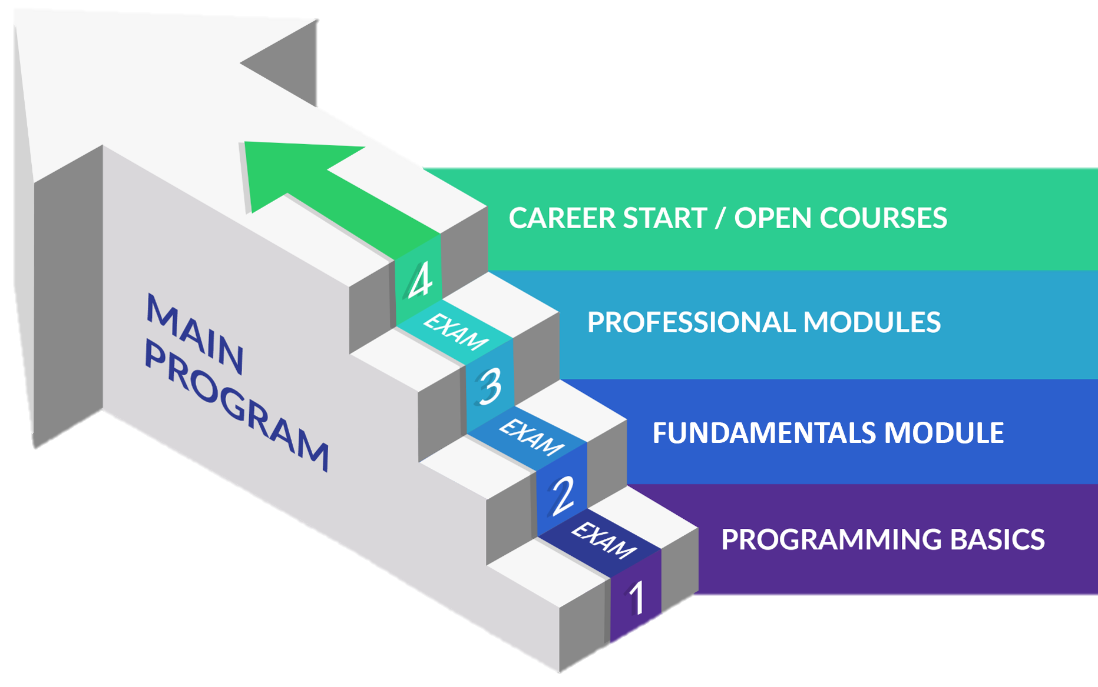
Software Engineering: Educational Program
Learning tracks: C#, Java, JavaScript, Python

Slide 39
Curriculum
Entry Module
Programming Basics
2 months
Fundamental Module
Fundamentals Module
4 months
Professional Modules
Java
C#
Python
JS
12-16 months
https://softuni.bg/trainings/courses

Slide 40
Questions?
Notes:
40

Slide 41
Trainings @ Software University (SoftUni)
Software University – High-Quality Education, Profession and Job for Software Developers
softuni.bg, about.softuni.bg
Software University Foundation
softuni.foundation
Software University @ Facebook
facebook.com/SoftwareUniversity
Software University Forums
forum.softuni.bg
Notes:
41

Slide 42

License
This course (slides, examples, demos, exercises, homework, documents, videos and other assets) is copyrighted content
Unauthorized copy, reproduction or use is illegal
© SoftUni – https://about.softuni.bg/
© Software University – https://softuni.bg
Notes:
42

